Slide 1


SIT720 Machine Learning Project Predicting Heart Failure Patient Survival
Mirna Arivalagan

Slide 2
Experiment Protocol
Feature Analysis
Feature Importance
Default Models Building
Hyper Parameter Tuning
Ensemble Model
Results

Slide 3
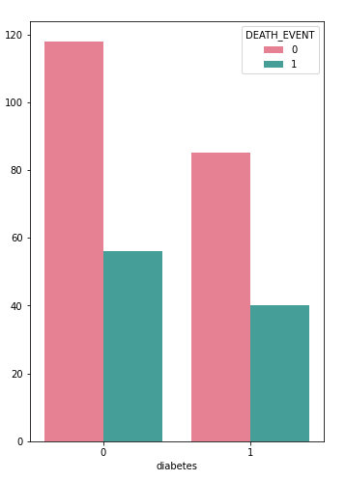
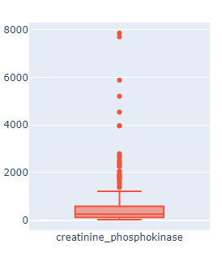
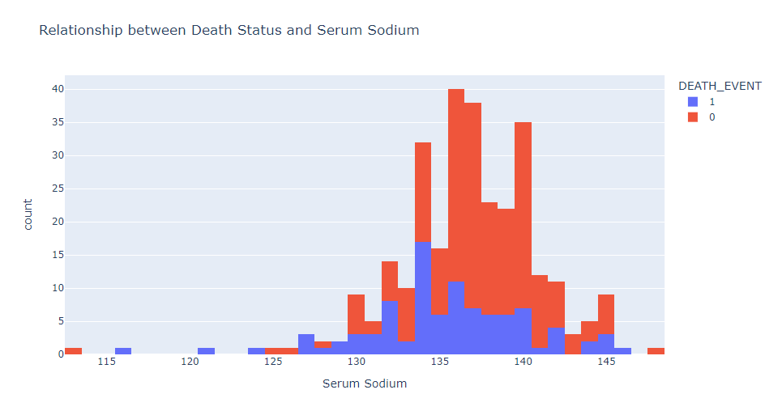
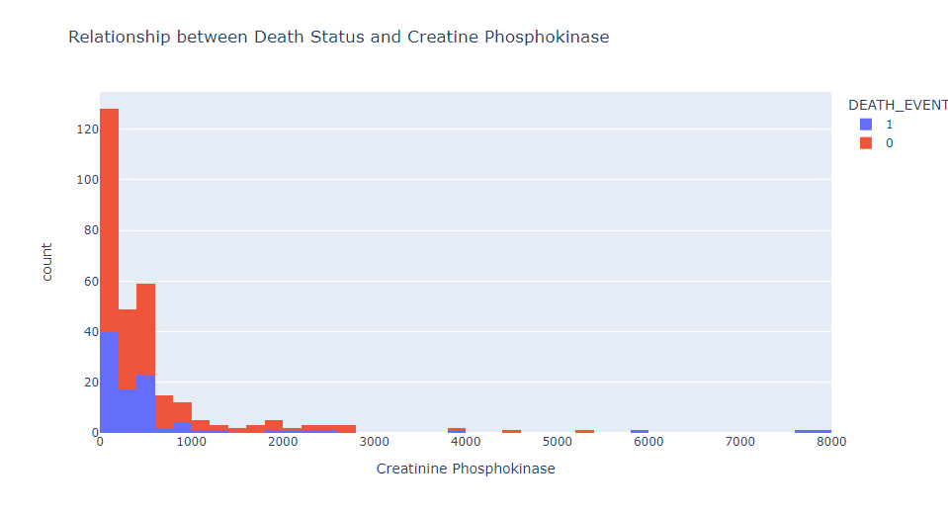
Feature Analysis
EDA analysis showed that some features are left and right skewed and there were outliers present.
Target feature also suffered from class imbalance
From this decision to use Robust Scaler, and class_weight = balanced parameter was made.

Slide 4
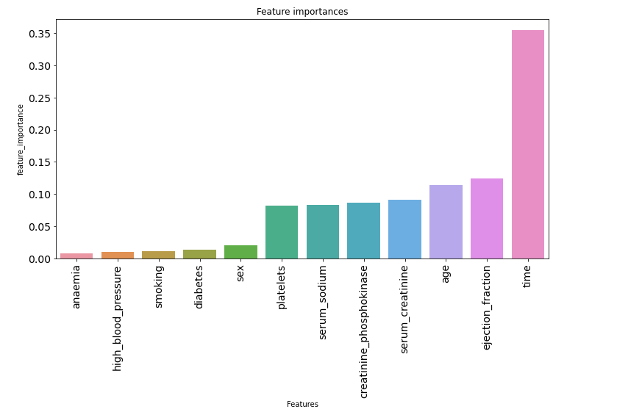
Feature Importance
Used Random Forest to identify important features
Time, Ejection_Fraction & Age were top 3 features.
Models did not perform well with age included, so I included serum_creatinine as the researchers have identified that this is a key predictor

Slide 5
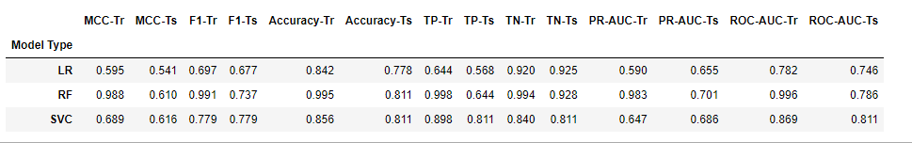
Default Model Building
Split dataset into 70% train and 30% test and ran model 100 times with default values for:
Random Forest, SVM (Kernel = Rbf) & Logistic Regression
Found that Random Forest model was suffering from overfitting issues

Slide 6
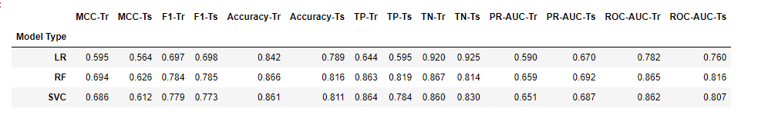
Hyper Parameter Tuning
By tuning the C and Gamma values for the SVM model, we have seen a tiny improvement.
By tuning the max depth, sample and estimator parameters for random forest, we have reduced the variance between train and test scores.
By tuning the logistic regression penalty and solver parameters, we have seen a small improvement in performances.
Utilized 3 fold cross validation in grid search package

Slide 7
Ensemble Model
I have chosen to use a voting classifier as my final model because of its unbiased nature. (Hard Voting)
By combining 3 different type of estimator models, we are maximizing on the strengths of each individual estimator model. We are also ensuring that the final prediction is more robust and accurate.
I fitted the hypertuned estimator models to the voting classifier and ran the model a 100 times to check that the model has strong predictive powers.

Slide 8
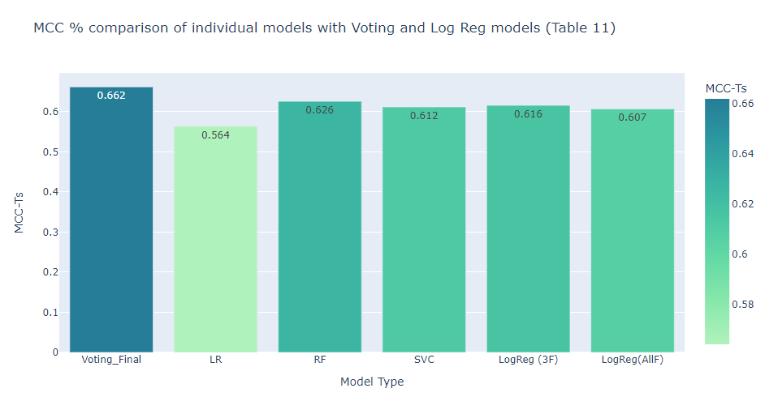
Matthews Correlation Coeffiecient %
The voting classifier outperformed all individual estimators and the 2 logistic regression model in the research paper.
Scored 66.2% for this metric.
A high MCC scores means that the model was able to predict True Positives, True Negatives, False Positives and False Negatives accurately, and is the best metric to use when dealing with class imbalance issues

Slide 9
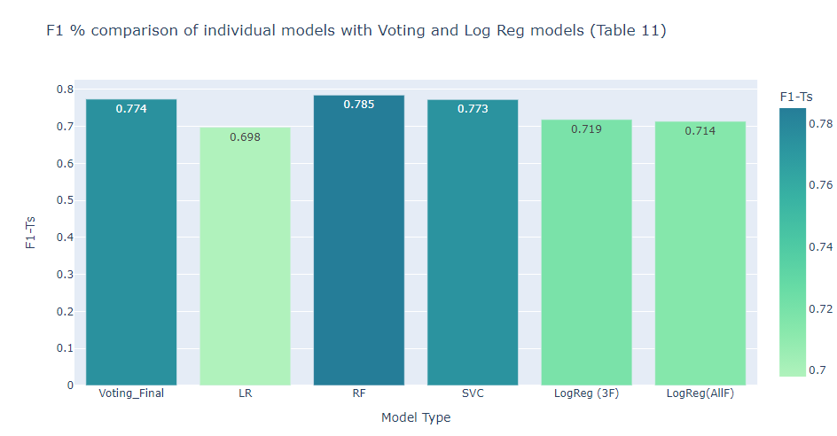
F1 Score %
The voting classifier outperformed the 2 logistic regression models by the researchers, but the Random Forest estimator outperformed slightly the voting classifier score.
Scored 77.4% for this metric.
This indicates that the model has a good precision and recall ability when predicting if a patient will survive or not.

Slide 10
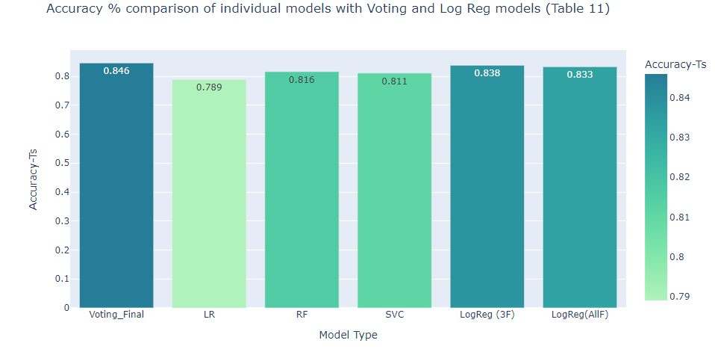
Accuracy %
The voting classifier outperformed all individual estimators and the 2 logistic regression models by the researcher.
Scored 84.6% for this metric.
Even though we scored high for this metric, it isn’t the best one to use when evaluating imbalanced dataset models.

Slide 11
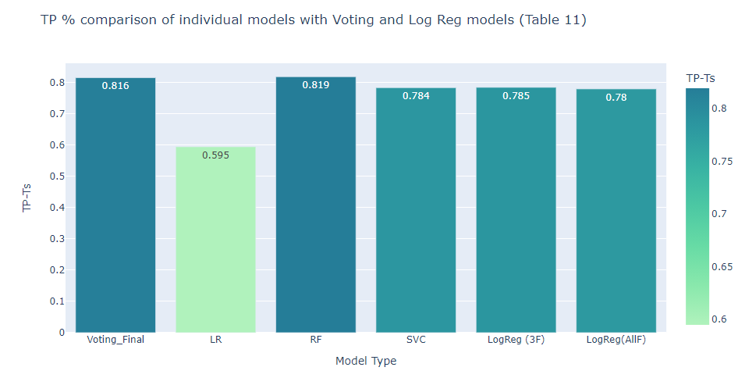
True Positive %
The voting classifier outperformed all individual estimators except for random forest and the 2 logistic regression models by the researcher.
Scored 81.6% for this metric.
This means that the model was able to classify patients who survived 81% of the time.

Slide 12
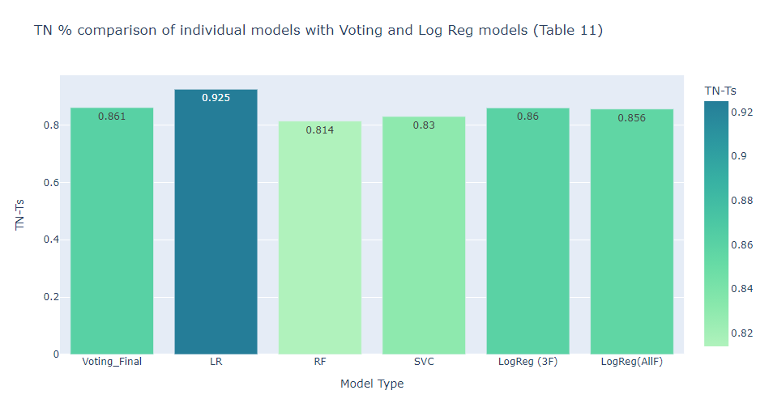
True Negative %
The voting classifier outperformed all individual estimators except for logistic regression, and the 2 logistic regression models by the researcher.
Scored 86.1% for this metric.
This means that the model was able to classify patients who died 86% of the time. Patients who died was what the model was built to predict and is the minority class, so the logistic regression model fitting into the voting classifier seemed to have been able to accurately classify this minority class 92.5% of the time.

Slide 13
Conclusion
By combining 3 different machine learning techniques into 1 ensemble model, we were able to generate predictions that are more accurate.
There are limitations to this experimentation as the sample size of 299 was quite small, we will need to test the same model on a larger sample for further learnings.
Applying smoting techniques did not improve the performance of the models further, meaning specifying class-weight = balanced did the trick.

